Slide 1
HTTP/1.1 200 OK
Server: skillsmatter.com
Content-Type: application/x-slides-and-code-and-crap-jokes
Cache-Control: remember, share, tell-your-friends
Content-Length: about-1½-hours
Date: Tue, 05 Apr 2011 18:30:00 BST
Set-Cookie: flavour=chocolate_chip; path=/;
X-Subject: JavaScript
X-Powered-By: monmouth-coffee-and-80s-music
X-Speaker-Name: Dylan Beattie
X-Speaker-Email: dylan@dylanbeattie.net
X-Speaker-Twitter: @dylanbeattie
X-Speaker-Website: www.dylanbeattie.net

Slide 2
So…
You think you know Javascript?
Notes:
Javascript is to modern software what the electric guitar is to modern music. Versatile, accessible, purists hate it, beginners love it, but it’s had such a profound and widespread impact that you really can’t ignore it.
It’s been called the “world’s most misunderstood programming language”, and tonight I’m hoping to clear up some of that misunderstanding, to explore how – and why – JS has ended up being so misunderstood, and to show you some of the amazing work that people are doing with this remarkable language.
First, though we’re going to play a game – make sure everybody’s awake. It’s time to play… NAME THAT LANGUAGE!

Slide 3
Name That Language – Round 1
int Factorial(int n) { if (n < 2) return(1); return n * Factorial(n - 1); }
Notes:
This is syntactically valid in C#, Java, C and C++ - so if anyone guesses, I can make sure they guess wrong ☺

Slide 4
Name That Language – Round 2
(define (factorial n) (if (< n 2) (1) (* n (factorial (- n 1))))
Notes:
This is Scheme – from whence Javascript took static scoping and its functional programming style.

Slide 5
Name That Language – Round 3
int Factorial(int n) { if (n < 2) return(1); return n * Factorial(n - 1); }
Notes:
Also C/C++/Java/C#

Slide 6
Name That Language – Round 4
PROC factorial = (INT upb n)LONG LONG INT:( LONG LONG INT z := 1; FOR n TO upb n DO z *:= n OD; z );
Notes:
This is Algol-60 – a truly remarkable language, and the first language to use lexical scoping.

Slide 7
Name That Language – Round 5
int Factorial(int n) { if (n < 2) return(1); return n * Factorial(n - 1); }
Notes:
Another C#/C/C++ slide. This is getting silly now.

Slide 8
Name That Language – Round 6
function Factorial(n) { if (n < 2) return(1); return n * Factorial(n - 1); }
Notes:
Javascript (yay!)

Slide 9
Name That Language – Round 7
Number extend [ my_factorial [ self < 0 ifTrue: [ self error: 'error' ]. self isZero ifTrue: [ ^1 ]. ^self * ((self - 1) my_factorial) ] ]
Notes:
Smalltalk – where EVERYTHING is an object.

Slide 10
Name That Language – Round 8
Number.prototype.factorial = function() {
if (this < 2) return(1);
return(this * ((this - 1).factorial()));
}
Notes:
Javascript – again, but this time OO javascript based on Smalltalk’s object system.

Slide 11
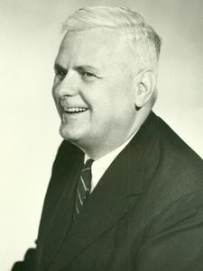
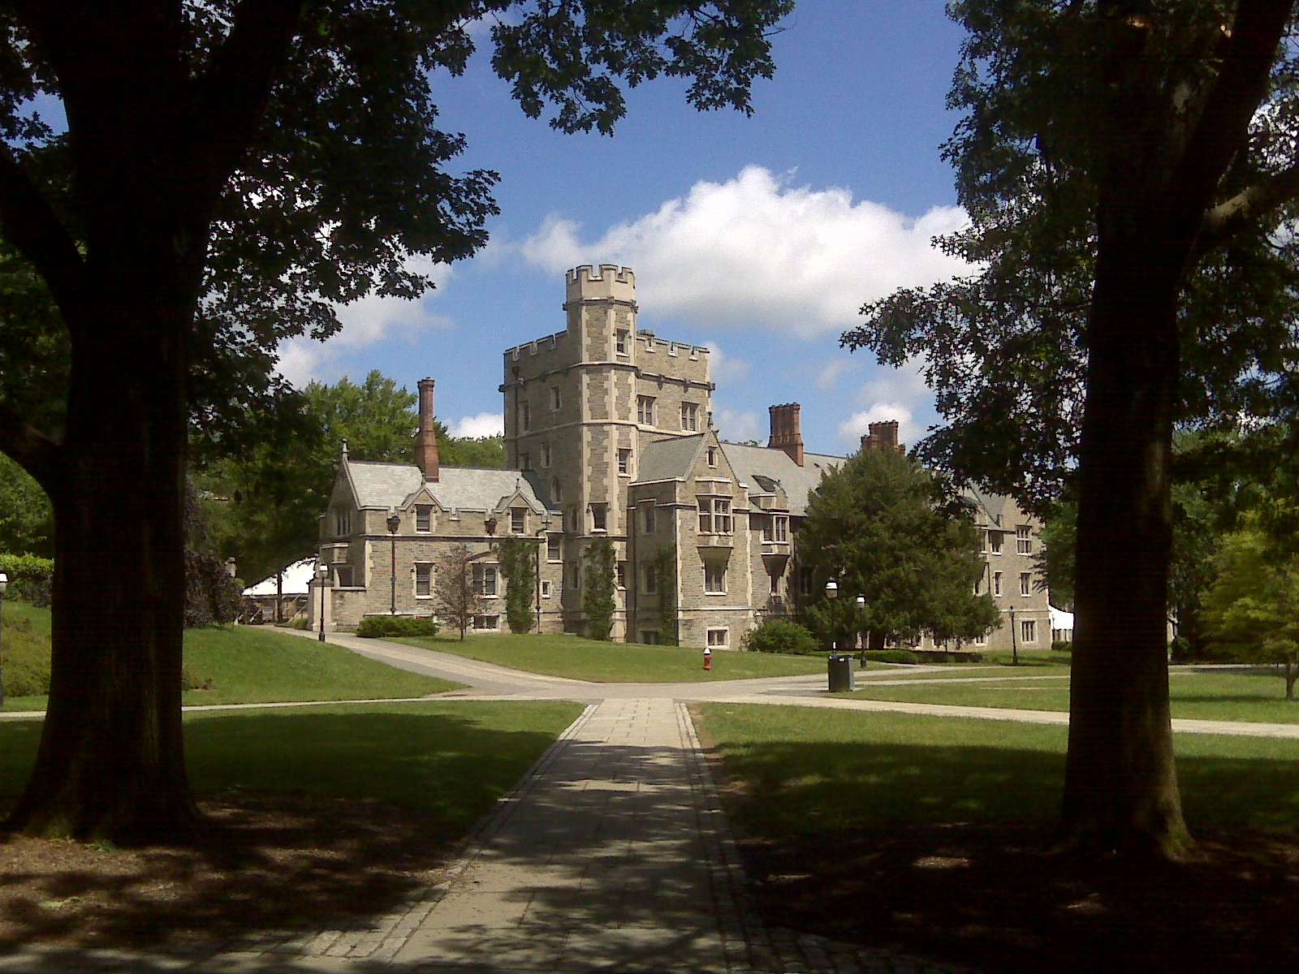
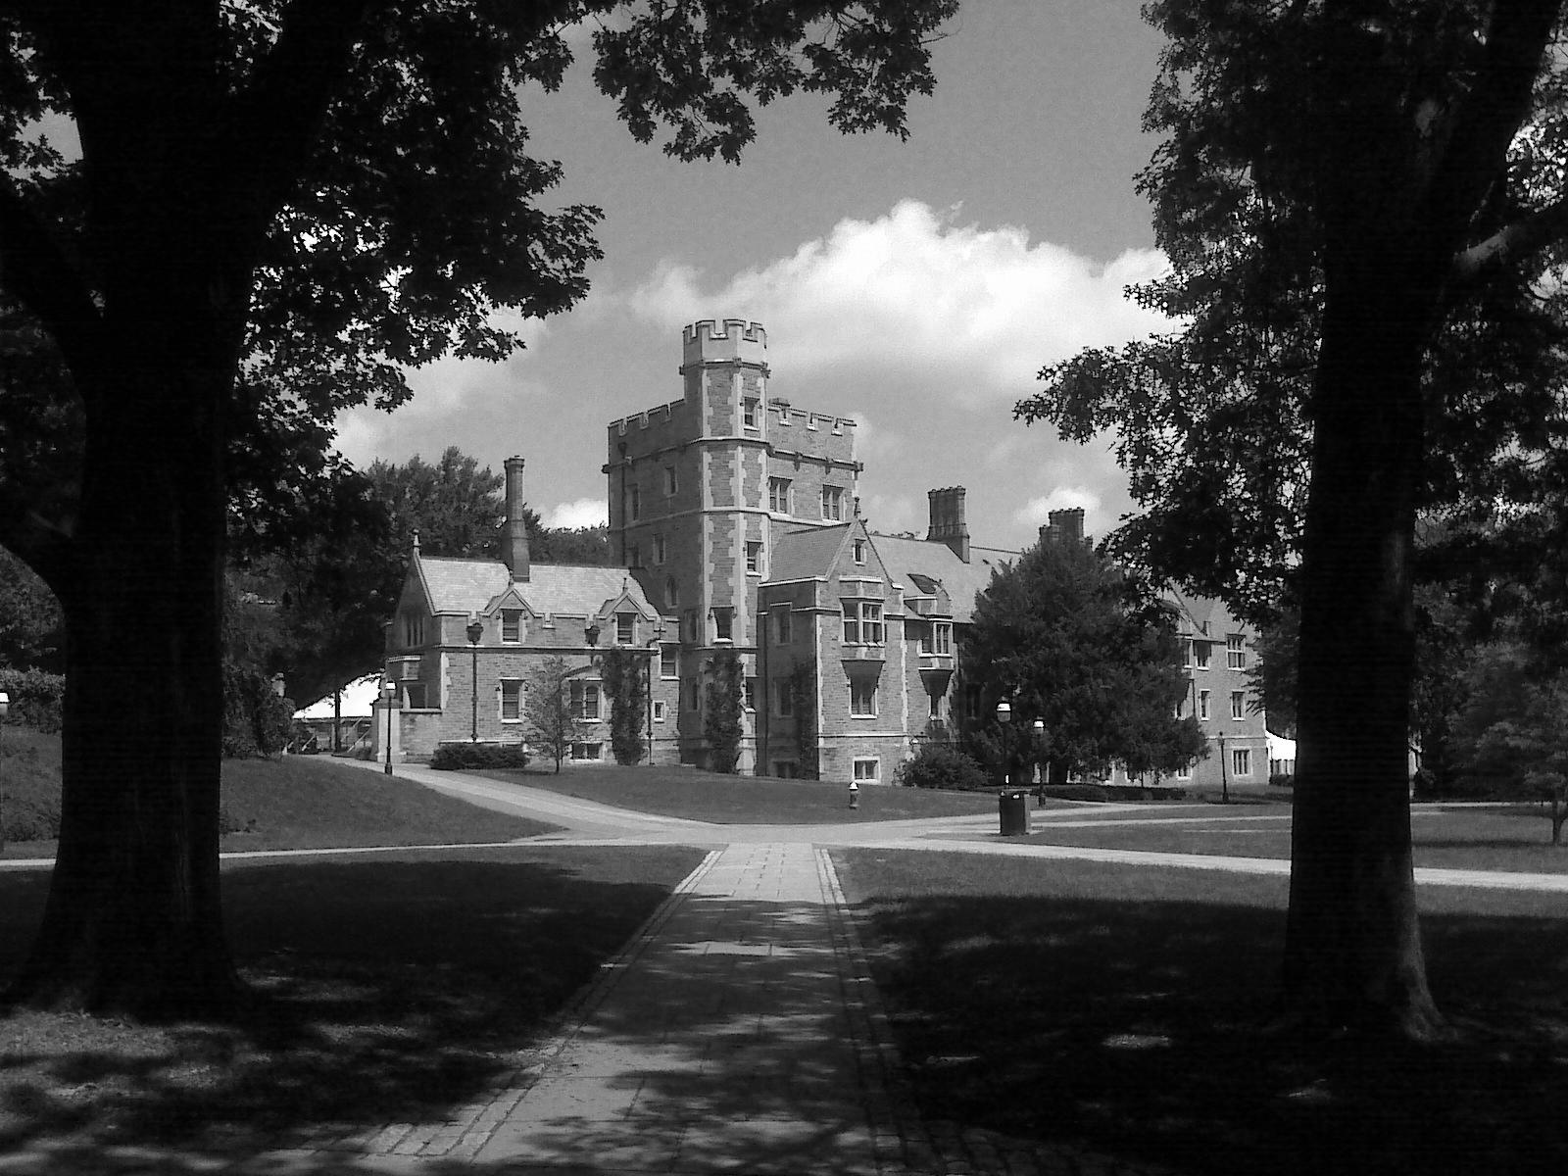
λ
Notes:
1936 – Princeton. Picture a scene something like Indiana Jones’ office in Raiders of the Lost Ark – wood-panelled studies, Gothic buildings and leafy campus lawns. Computers don’t exist yet and computability is still somewhere between mathematics and philosophy. Following long correspondence with Kurt Godel on the theory of computability, the American mathematician Alonzo Church creates a formal notation for studying the definition and application of functions. Church chooses the greek letter Lambda to represent anonymous functions in his notation, and his work becomes known as the lambda calculus.
If you’ve ever wondered why anonymous functions in .NET and Python are known as “lambdas” – that’s why.
Church went on to supervise Alan Turing’s PhD at Princeton; and together, their work has become known as the “Church-Turing thesis” – one of the most important theorems in computer science - which basically states that everything computable is computable by a Turing machine.

Slide 12
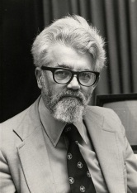
()
Notes:
Twenty-odd years later, this man - John McCarthy - joins MIT and starts the MIT AI Project. In 1960, he John McCarthy publishes his design for a new language, based on lists of symbols – he calls the language “Lisp”, short for “list processing”, and one of the key features of his theoretical language design is a routine called eval.
One of his grad students, Steve Russell, realizes that the eval function, as well as being part of the language design, would actually work as a Lisp interpreter – and implements it, in machine code on an IBM 704. Suddenly Lisp exists. Steve Russell goes on to make computer history by writing Spacewar! for the PDP10 minicomputer – one of the first computer games ever created – and Lisp proves so successful that it’s still in use today.

Slide 13

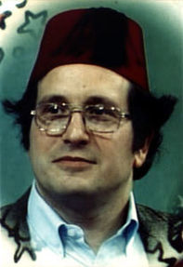
() + λ
Notes:
The next step on the road to Javascript takes place around 1975. CLICK Guy L Steele – famous as the GLS who edited the Hackers Jargon File for most of the 1980s – and his colleague Gerald Jay Sussman set out to create a “minimalist dialect” of Lisp (c.f. Common Lisp). In a series of publications known as the “lambda papers”, they develop a new dialect of Lisp, very closely based on Alonzo Church’s original lambda calculus. Originally a derivation of an earlier programming language called Planner – they dubbed it Schemer, but the PDP-10 had a 6-character limit on the ITS file-system, hence SCHEME.
Scheme was the first dialect of Lisp to choose lexical or static scope (borrowed from Algol) – which we’ll look at in a moment.

Slide 14
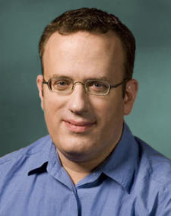
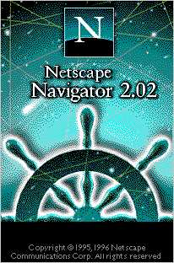
Notes:
The next milestone is the bit no-one’s ever heard of – an “extreme object-oriented language” called Self, developed at Xerox Parc in the 1980s. Self is notable because it was the first language to introduce prototyped inheritance – something we’ll be discussing quite a lot in the next hour or so – but other than that, the language is so obscure I couldn’t even find a factorial example to use in the Name That Language game earlier.
Anyway. Let’s fast-forward to April 1995. Netscape are gearing up for their big dot-com-bubble IPO, and someone decides their new browser should have some sort of programming language in it. They call Brendan Eich, an engineer who cut his teeth writing operating systems for Silicon Graphics, and ask if he wants to come over and “implement Scheme in their browser”
(http://brendaneich.com/tag/history/) – sounds weird now, but at the time there were bespoke macro languages, and there was Emacs and AutoLISP.
Eich ends up – like all of us have – stuck between a wealth of industry knowledge and best practise on one hand, and crazy marketing pressure on the other. Java was huge, Netscape were courting Sun to ship Java in their browser, and Bill Joy (founder of Sun Microsystems) grokked the idea of a light-weight scripting language as a companion to full-blown compiled Java applets. Netscape upper management said the language “must look like Java” and there was a general consensus that it had to run in the browser, in source form – no linkers, no compilers. He’s said "JS had to “look like Java” only less so, be Java’s dumb kid brother or boy-hostage sidekick. Plus, I had to be done in ten days or something worse than JS would have happened“ (http://en.wikipedia.org/wiki/Brendan_Eich)
So Eich cherry-picks. He borrows his syntax from Java. From an obscure OO language called Self, he borrows something called prototyped inheritance. He borrows the “function” keyword from Awk, regular expression literals from Perl, and pretty much everything else from Scheme. And it worked. Kinda. Eich said in 2008 that “he still thinks of JS as the quickie love-child of C and Self; the part that is good is not original, and the part that is original is not good” (http://brendaneich.com/tag/history/) but as we’ll see tonight, it doesn’t seem to have done JS’ popularity any harm.
August 11, 1995 – Alonzo Church dies in Ohio aged 92.
September 1995 – “LiveScript” makes its debut in Netscape Navigator 2.0 beta, the same month that Larry Page joins Sergey Brin at Stanford.
December 4th, 1995 – Livescript officially renamed to Javascript, confusing everybody.
March 1996 – official release of Netscape 2.0 and the first release of Javascript.

Slide 15

Notes:
That summer, Microsoft bring out Internet Explorer 3.0, which supports almost everything… except the document.images array. Hands up anyone who was writing Javascript in 1996. What were you doing with it? Fancy image roll-overs? Yeah, me too.
Interesting to note that in IIS 3.0 – JScript on the server, which (along with Netscape’s LiveWire server) meant there were two competing implementations of server-side Javascript as far back as 1997.
Netscape could probably have sued – or *something* - but instead, they decided to make their language an open standard.
JavaScript submitted to ECMA in Nov 1996, concerned that standardizard (driven by document.images lack of support in IE3) was necessary for widespread adoption
ECMA-262 v1 adopted in June 1997, and in Oct 1997 – IE 4 includes JScript 3, the first non-Netscape implementation of ECMA 262

Slide 16
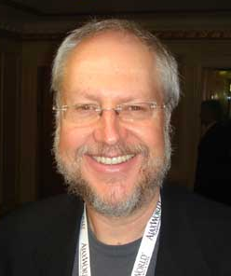
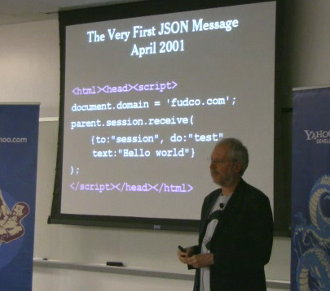
Notes:
1999 – IE5 introduces the XMLHTTP ActiveX control, but nobody notices because it’s ActiveX, it’s IE only, and no-one’s really doing anything much with it.
2000 – Outlook Web Access
2001 – the first JSON message.
Doug Crockford (Yahoo) “discovered” JSON in 2001
He says he’s since discovered someone at Netscape was using JS array literals for communication as early as 1996.
JSON – originally going to be called “jizmal” – the JavaScript Message Language
- but there was already the Java Speech Markup Language
- so they renamed it JSON
he says he didn’t invent it; he discovered it, named it and gave it a domain –
2002 – Douglas Crockford launches JSON.org
2003 (?) – Google Suggest – I can remember thinking “wow…”
2004 April 1st – Google announce GMail (invitation-only beta) and everyone assumes a gigabyte of free webmail is an April Fool’s joke.
2005 – (Feb 8th) Google Maps launches
Feb 18th – Jesse James Garrett coins the term Ajax (Asynchronous JavaScript + XML) to describe the new approach to web apps demonstrated by Google Suggest and Google Maps
June 2005 – Apple open-source WebKit
Aug 2005 – Doug Crockford joins Yahoo as Javascript Architect
Dec 2005 – Yahoo! begins offering JSON support for web services.
We have technology, we have cool names, we have killer apps, and the future is so bright we’re all wearing shades…

Slide 17






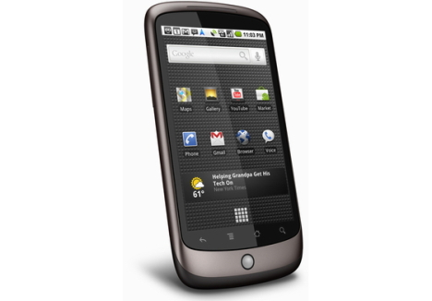
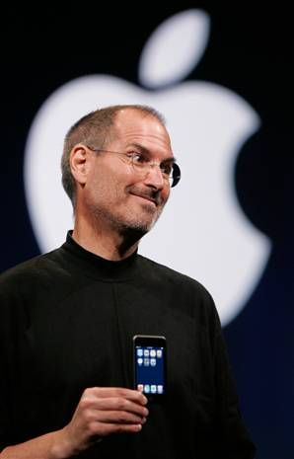
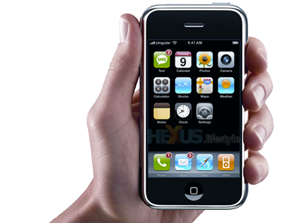
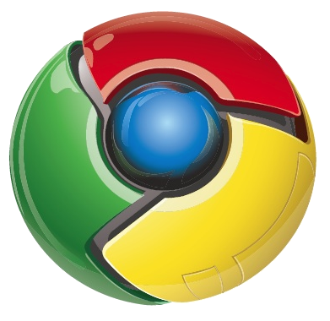
Notes:
CLICK March 21st, 2006 – Jack Dorsey tweets “Just setting up my twttr”
CLICK August 2006 – John Resig launches jQuery 1.0
John Resig is to Javascript what Jimi Hendrix was to the electric guitar – he did something singularly amazing that just wouldn't have been possible using anything else.
CLICK January 29th, 2007 – Apple announces the iPhone
CLICK November 5th, 2007 – Open Handset Alliance announce Android smartphone OS based on Linux Kernel 2.6
CLICK September 2008 – Google release Chrome beta
CLICK August 2009 – ServerJS renamed to CommonJS
NodeJS presented at JSConf
Jan 2010
Open source IronJS project announced – a full .NET implementation of Javascript written on top of the DLR using F#
CLICK Google launch the Nexus One handset
CLICK April 2010 – Steve Jobs famous “Thoughts on Flash”
May 2010 – Google announce the “Chrome Web Store”
The Chrome web store goes live on December 6th, 2010 – and suddenly Javascript is the backbone of a new software ecosystem. The same code will run on your phone, your browser and your server. It’s in the cloud. It’s on Mac, Linux and Windows, and the age-old promise of “write once, run anywhere” suddenly looks like it might actually come true.
So – how does it work?

Slide 18
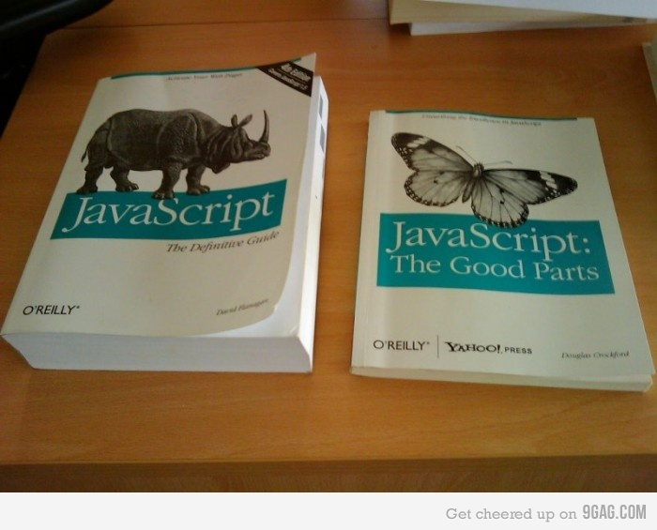
Notes:
This photograph is not fair. But it made me laugh. Plus, the one on the left is full of browser DOM shit like document.layers and Netscape 4.
If you’re going to grok Javascript, there’s a couple of core concepts that, once you get your head around them, everything will start making a lot more sense.
Once you actually want to USE it, there’s a couple of gotchas to watch out for.

Slide 19
Functions
function combine(f1, f2) {
return(function(x) { f1(f2(x))
});
}
Notes:
Javascript is a functional language. Functions are first-class objects – you can copy them, assign them, stick them in arrays, pass them into other functions – anything you can do with a variable, you can do with a function. You can even write functions that return other functions.

Slide 20
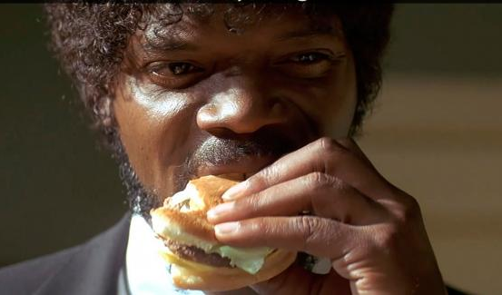

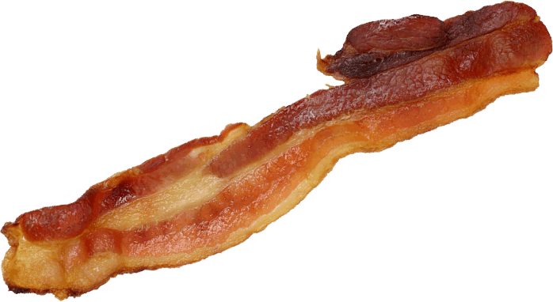
Functions (with cheese & bacon)
function addCheese(food) {
return(food + “ plus cheese”);
}
function addBacon(food) {
return(food + “ plus bacon”);
}
function makeTasty(food) {
return(combine(addCheese, addBacon));
}
alert(makeTasty(“burger”));
// will return “burger plus cheese plus bacon”
// ...that SURE IS a Tasty Burger.
Notes:
Javascript is a functional language. Functions are first-class objects – you can copy them, assign them, stick them in arrays, pass them into other functions – anything you can do with a variable, you can do with a function. You can even write functions that return other functions.

Slide 21
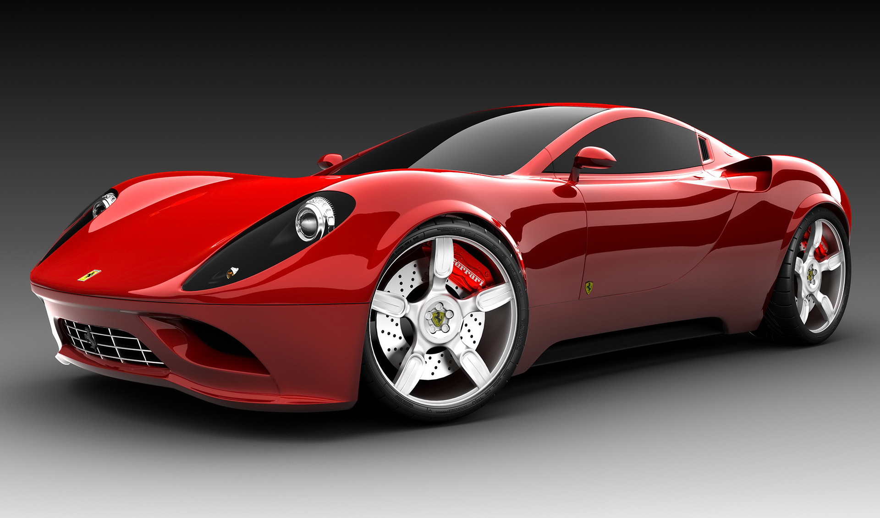
Prototyped inheritance
Notes:
In Self, and other prototype-based languages, the duality between classes and object instances is eliminated.
In classical inheritance, when you pass someone an instance of vehicle, the compiler refers to the class declaration to see what it can do.
In prototyped inheritance, every instance keeps a REFERENCE to its originating class, but that’s just a loose object reference. Objects are disconnected from their definitions.
Classical inheritance – you get your new Ferrari, and you phone the dealer and say “Hi. What can Ferraris do?”
You want to stick on allows and a spoiler and go-faster-stripes – you can’t. You need to declare a new class – which is kinda like opening a new Ferrari factory that takes Ferraris from the existing factory and puts stripes on all of them.
Prototype inheritance – you look at your Ferrari and think “hey, I wonder what this thing can do?”
And if you want to stick spoilers and stripes on it – you go right ahead. It’s yours, after all.

Slide 22
Prototyped inheritance
function Ferrari(color) {
this.color = color;
}
var bob = new Ferrari("yellow");
/* … some code here... */
bob.goFaster(); // what happens here?
Notes:
So what happens when you call bob.goFaster?
It sees whether bob can go fast – and if it can't, it looks to see what Bob was copied from (what was bob's prototype), and asks whether thatcan go faster.

Slide 23
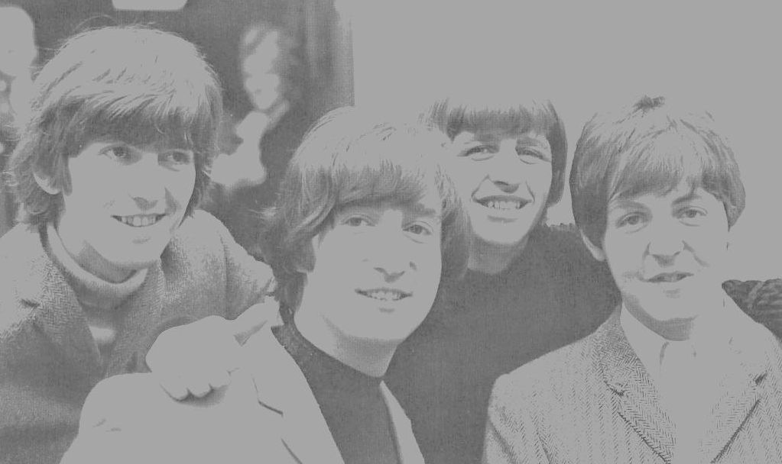
Object Literals
var theBeatles = {
guitar: "John Lennon",
guitar: "George Harrison",
bass: "Paul McCartney",
drums: "Ringo Starr",
play: function() { return("Twist and shout!");
}
};
Notes:
Instances with no class declaration. You just say "put this there, that over there, that over there, and you're done"

Slide 24
Objects, Functions, Hashes
function Ferrari(color) {
this.color = color;
}
var bob = new Ferrari("yellow");
// These are equivalent:
bob.color;
bob['color'];

Slide 25
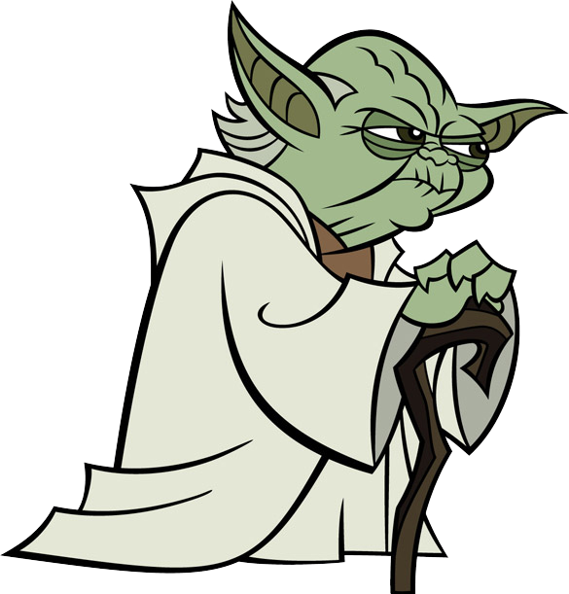
Exceptions
Notes:
Anyone put Jedi on their census form last week? Yeah? Then I apologise, but I'm about to commit heresy, 'cos whilst your religious leader – the little green guy with the pointy ears – says "there is no try", he clearly wasn't a Javascript programmer…

Slide 26
Exceptions
try {
// do something dangerous
// like wrestling a radioactive shark
// or connecting to Sharepoint web services
} catch(ex) {
alert(ex);
} finally {
// clean up radioactive shark mess
// or disconnect from Sharepoint service.
}

Slide 27
Closures and Callbacks
Idiomatic jQuery:
$(element).fadeIn(500, function() {
element.slideUp(500, function() {
element.remove();
});
});

Slide 28
Some Syntactic Goodies
Regex literals:
if (/jpg$/.test(filename)) alert("It's a JPEG!");
Single or double quotes (just like HTML)
var html = '<a href="http://jquery.com/">jQuery</a>';
var html = "<a href='http://jquery.com/'>jQuery</a>";

Slide 29
Javascript: The Gotchas
Notes:
The Javascript compiler will bite you in the ass. Guaranteed.

Slide 30
Scope and Hoisting
function doStuff() {
var x = "Hello!";
for(var x = 0; x < 2, x++) { alert('Hi');
}
alert(x);
}
Notes:
The only place var means anything is inside a function block.
Every var inside a function block is "hoisted" to the top.

Slide 31
this and Event Handlers…
function SpaceInvaders() {
this.score = 0;
this.fire = function() {
if (this.shoot()) this.score++;
}
}
var game = new SpaceInvaders();
var fireButton = document.getElementById("fireButton")
fireButton.onclick = game.fire;
Notes:
When you're assigning event handlers, you are NOT saying "when I click this button, instantiate a new Controller object and run the Click() method on it" You are saying "there is a block of code that happens to be on that Controller object, and I want you to use that code as your click handler"
"this" does not mean "the object that defined this behaviour", it means "the object that INVOKED this behaviour"
So when you assign a code to a button's click event, when the code runs, 'this' refers to the button – NOT to the controller or object that defines it.

Slide 32
this and Event Handlers…
function SpaceInvaders() {
this.score = 0;
this.fire = function() {
if (this.shoot()) this.score++;
}
}
var game = new SpaceInvaders();
var fireButton = document.getElementById("fireButton")
fireButton.onclick = game.fire;
Notes:
When you're assigning event handlers, you are NOT saying "when I click this button, instantiate a new Controller object and run the Click() method on it" You are saying "there is a block of code that happens to be on that Controller object, and I want you to use that code as your click handler"
"this" does not mean "the object that defined this behaviour", it means "the object that INVOKED this behaviour"
So when you assign a code to a button's click event, when the code runs, 'this' refers to the button – NOT to the controller or object that defines it.

Slide 33
call and binding
Function.prototype.bind = function () {
if (arguments.length < 2 && arguments[0] === undefined) {
return this;
}
var thisObj = this,
args = Array.prototype.slice.call(arguments),
obj = args.shift();
return function () {
return thisObj.apply(obj, args.concat(Array.prototype.slice.call(arguments)));
};
};
Function.bind = function () {
var args = Array.prototype.slice.call(arguments);
return Function.prototype.bind.apply(args.shift(), args);
}
Notes:
When you're assigning event handlers, you are NOT saying "when I click this button, instantiate a new Controller object and run the Click() method on it" You are saying "there is a block of code that happens to be on that Controller object, and I want you to use that code as your click handler"
"this" does not mean "the object that defined this behaviour", it means "the object that INVOKED this behaviour"
So when you assign a code to a button's click event, when the code runs, 'this' refers to the button – NOT to the controller or object that defines it.

Slide 34
this and Event Handlers (2)
function SpaceInvaders() {
this.score = 0;
this.fire = function() {
if (this.shoot()) this.score++;
}
}
var game = new SpaceInvaders();
var fireButton = document.getElementById("fireButton")
fireButton.onclick = game.fire.bind(game);
Notes:
When you're assigning event handlers, you are NOT saying "when I click this button, instantiate a new Controller object and run the Click() method on it" You are saying "there is a block of code that happens to be on that Controller object, and I want you to use that code as your click handler"
"this" does not mean "the object that defined this behaviour", it means "the object that INVOKED this behaviour"
So when you assign a code to a button's click event, when the code runs, 'this' refers to the button – NOT to the controller or object that defines it.

Slide 35
Arrays that aren’t really arrays
var people = [];
people.push('Alice');
people[7] = 'Bob'
people['boss'] = 'Bruce';
Notes:
The length of an array is the highest integer index, plus one. Javascript arrays aren't real (they're dynamically allocated so you can't ever go out of bounds). jQuery riffs on this in a big way, returning collections that define their own indexer properties so they look and behave like arrays, but they're actually the jQuery object.

Slide 36
Type coercion
"5" + 3 = 53
because string concatenation 'wins'
"5" – 3 = 2
because the subtraction operator isn't defined for strings, so the "5" is parsed into a number
Notes:
Be careful.
Dates – all date/times are true EXCEPT midnight on January 1st, 1970. As someone said who was there "It was midnight, New Years Eve, the dawn of a new decade, and there was optimism everywhere; everyone thought Vietnam was over, Nixon was honest, and we'd all be living on the moon by 2001. Looking back on it – it *was* false"
"false" is true. "0" is true.
"5" + 3 = 53
"5" – 3 = 2

Slide 37
"truthy" and "falsy"
False Things:
The empty string
Zero
NaN
null
([] == true)
True Things:
everything else
([])
([] == false)

Slide 38
JavaScript: The Missing Pieces
Notes:
Javascript defines NOTHING. The core language has no networking, no I/O, no filesystem access – in fact, it doesn't even define any extension mechanism for adding these things.
Making Javascript talk to the rest of the world is ALL about the host – the engine that's actually running the code.
When the engine is a browser, Javascript gets full access to the DOM, and to various things like XMLHttpRequest that are exposed by the browser's Javascript runtime. You know that slide earlier about "Javscript: The Complete Guide" vs "Javascript: The Good Parts" ? That's because the Complete GUide actually covers every DOM element, event and attribute, and documents their cross-browser implementations and compability issues.

Slide 39


Slide 40
Knockout

Slide 41
JavaScript Pop Quiz #1
var alerts = [];
for(var x = 0; x < 3; x++) {
alerts.push(function() { document.write(x + ', '); });
}
for (var y = 0; y < 3; y++) { (alerts[y])(); }
for (var x = 0; x < 3; x++) { (alerts[x])(); }

Slide 42
Layout Engines (Tempo)

Slide 43
JavaScript Pop Quiz #2
function GetGuru() { return {
name = 'Jon Skeet',
job = 'Guru'
};
}
function GetGuru()
{
return
{
name = 'Jon Skeet',
job = 'Guru'
};
}

Slide 44
CommonJS
how to use requires
Notes:
Defines an extension mechanism for Javascript.
Beautifully done – and we'll look at it in a second.

Slide 45
A Simple Server in NodeJS

Slide 46
Javascript Pop Quiz #3
try { return(true);
} finally { return(false);
}

Slide 47
Manifests

Slide 48
Web Sockets

Slide 49
Thank you
http://www.dylanbeattie.net/javascript/
Twitter @dylanbeattie
dylan@dylanbeattie.net

Slide 50
HTTP/1.1 307 Redirect
Location: http://www.theslaughteredlambpub.com/ Content-Type: refreshment/x-beer-and-more-crap-jokes Content-Length: until-they-throw-us-out X-Thanks-To: Steve Sanderson Tom Scott Ian Cooper SkillsMatter
X-More-Info-At http://www.dylanbeattie.net/javascript/ X-Speaker-Name: Dylan Beattie X-Speaker-Email: dylan@dylanbeattie.net X-Speaker-Twitter: @dylanbeattie

